Slide 1

BS – 101 Engineering Physics
Lecture – 11
Engr. Safee Ullah

Slide 2
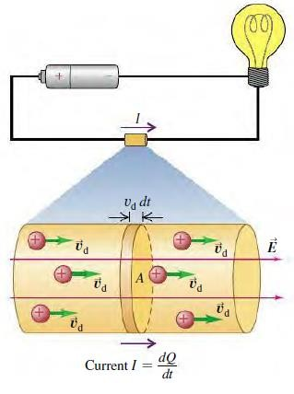
Current, Drift Velocity and Current Density
Let’s reconsider the situation of a conductor as shown in figure.

Slide 3
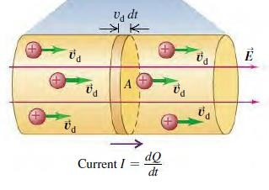
Current, Drift Velocity and Current Density (Contd.)
A conductor with cross-sectional area A and an electric field E directed from left to right. To begin with, we’ll assume that the free charges in the conductor are positive; then the drift velocity is in the same direction as the field.

Slide 4
Current, Drift Velocity and Current Density (Contd.)
Suppose there are n moving charged particles per unit volume. Assume that all the particles move with the same drift velocity with magnitude 𝑣_{𝑑} . In a time interval 𝑑𝑡, each particle moves a distance 𝑣_{𝑑}𝑑𝑡.

Slide 5
Current, Drift Velocity and Current Density (Contd.)
The volume of the cylinder is A𝑣_{𝑑}𝑑𝑡, and the number of particles within it is nA𝑣_{𝑑}𝑑𝑡. If each particle has a charge q, the charge 𝑑𝑄 that flows out of the end of the cylinder during time 𝑑𝑡 is
𝑑𝑄 = 𝑞(nA𝑣_{𝑑}𝑑𝑡) = 𝑛𝑞𝑣_{𝑑}𝐴 𝑑𝑡

Slide 6
Current, Drift Velocity and Current Density (Contd.)
And the current is
𝐼 = ^{𝑑𝑄} = 𝑛𝑞𝑣 𝐴
𝑑𝑡
𝑑
The current per unit cross-sectional area is called the current density J:
𝐽 = ^{𝐼} = 𝑛𝑞𝑣
𝐴
𝑑
The units of current density are amperes per square meter ( ).
_{𝑚}2
𝐴

Slide 7
Current, Drift Velocity and Current Density (Contd.)

